Slide 1
VR SoundEscape
By Matthew Mulcahy

Slide 2
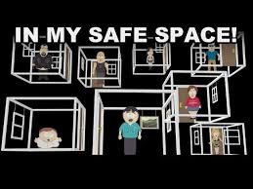

What it is
Using the power of Music as relaxation
Combined with a beautiful and calming setting
Ultimately a Safe Space

Slide 3
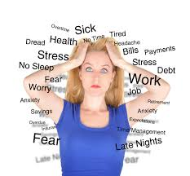

Target users
People with:
  High Stress
  High Anxiety
  Mental health problem
Trying to help with that sense of “I don’t want to be here anymore”

Slide 4
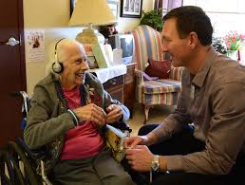
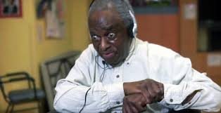
Understanding of the experience
Feeling of safety and relaxation
Better Understanding of themselves
Music immersion therapy

Slide 5
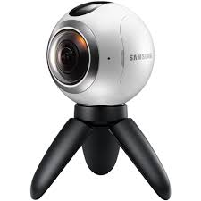
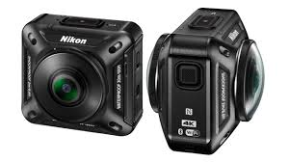
Storytelling Techniques
360 Video will be the main tool as well as some careful edits.

Slide 6
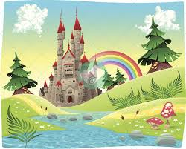
Plan of Action
Create a space that is perfect environment of dreamlike while at the same time not making it too busy.
Want to give people a sense of order, I don’t want to overwhelm anyone
Issues: matching a scene and room that most people would think pair well.

Slide 7
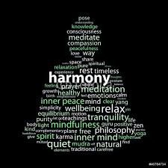
Plan for the Future
For one I would plan to use this technology to help myself whenever I feel overwhelmed by something
People are living in this state of constant fear and I want to change that

