Slide 1
sPACE IN SPACE: 360
By Josh Rosenblatt

Slide 2

THE EXPERIENCE

Slide 3

Target user

Slide 4

What will people learn

Slide 5
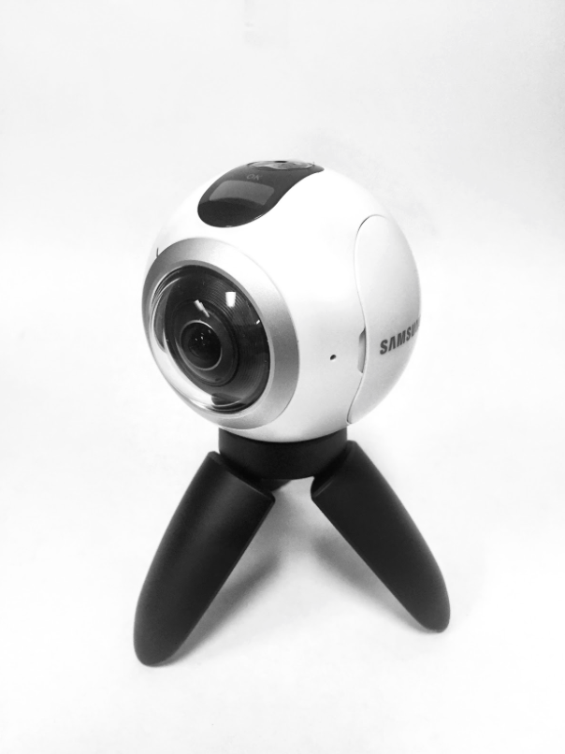
Techniques

Slide 6

PLAN OF ACTION

Slide 7

Future career

