Slide 1
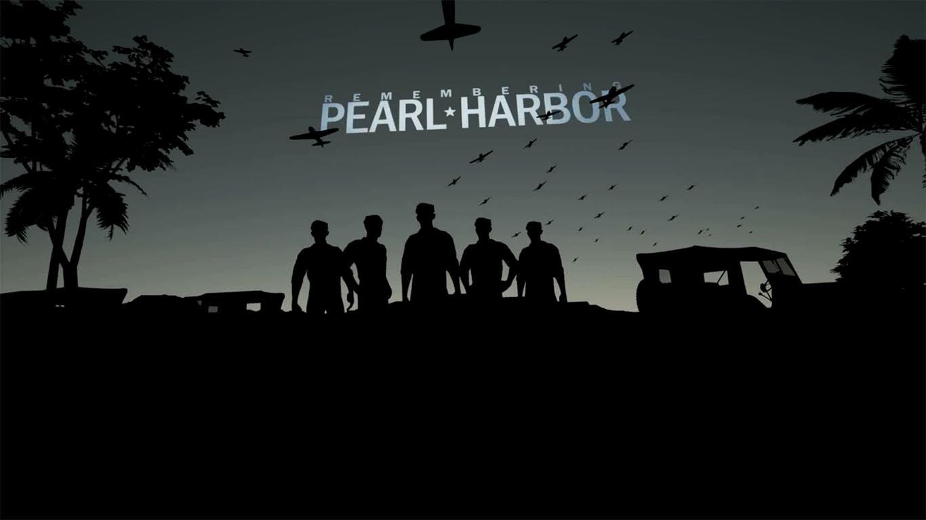
Remembering Pearl Harbor VR Experience
Michael Ger

Slide 2
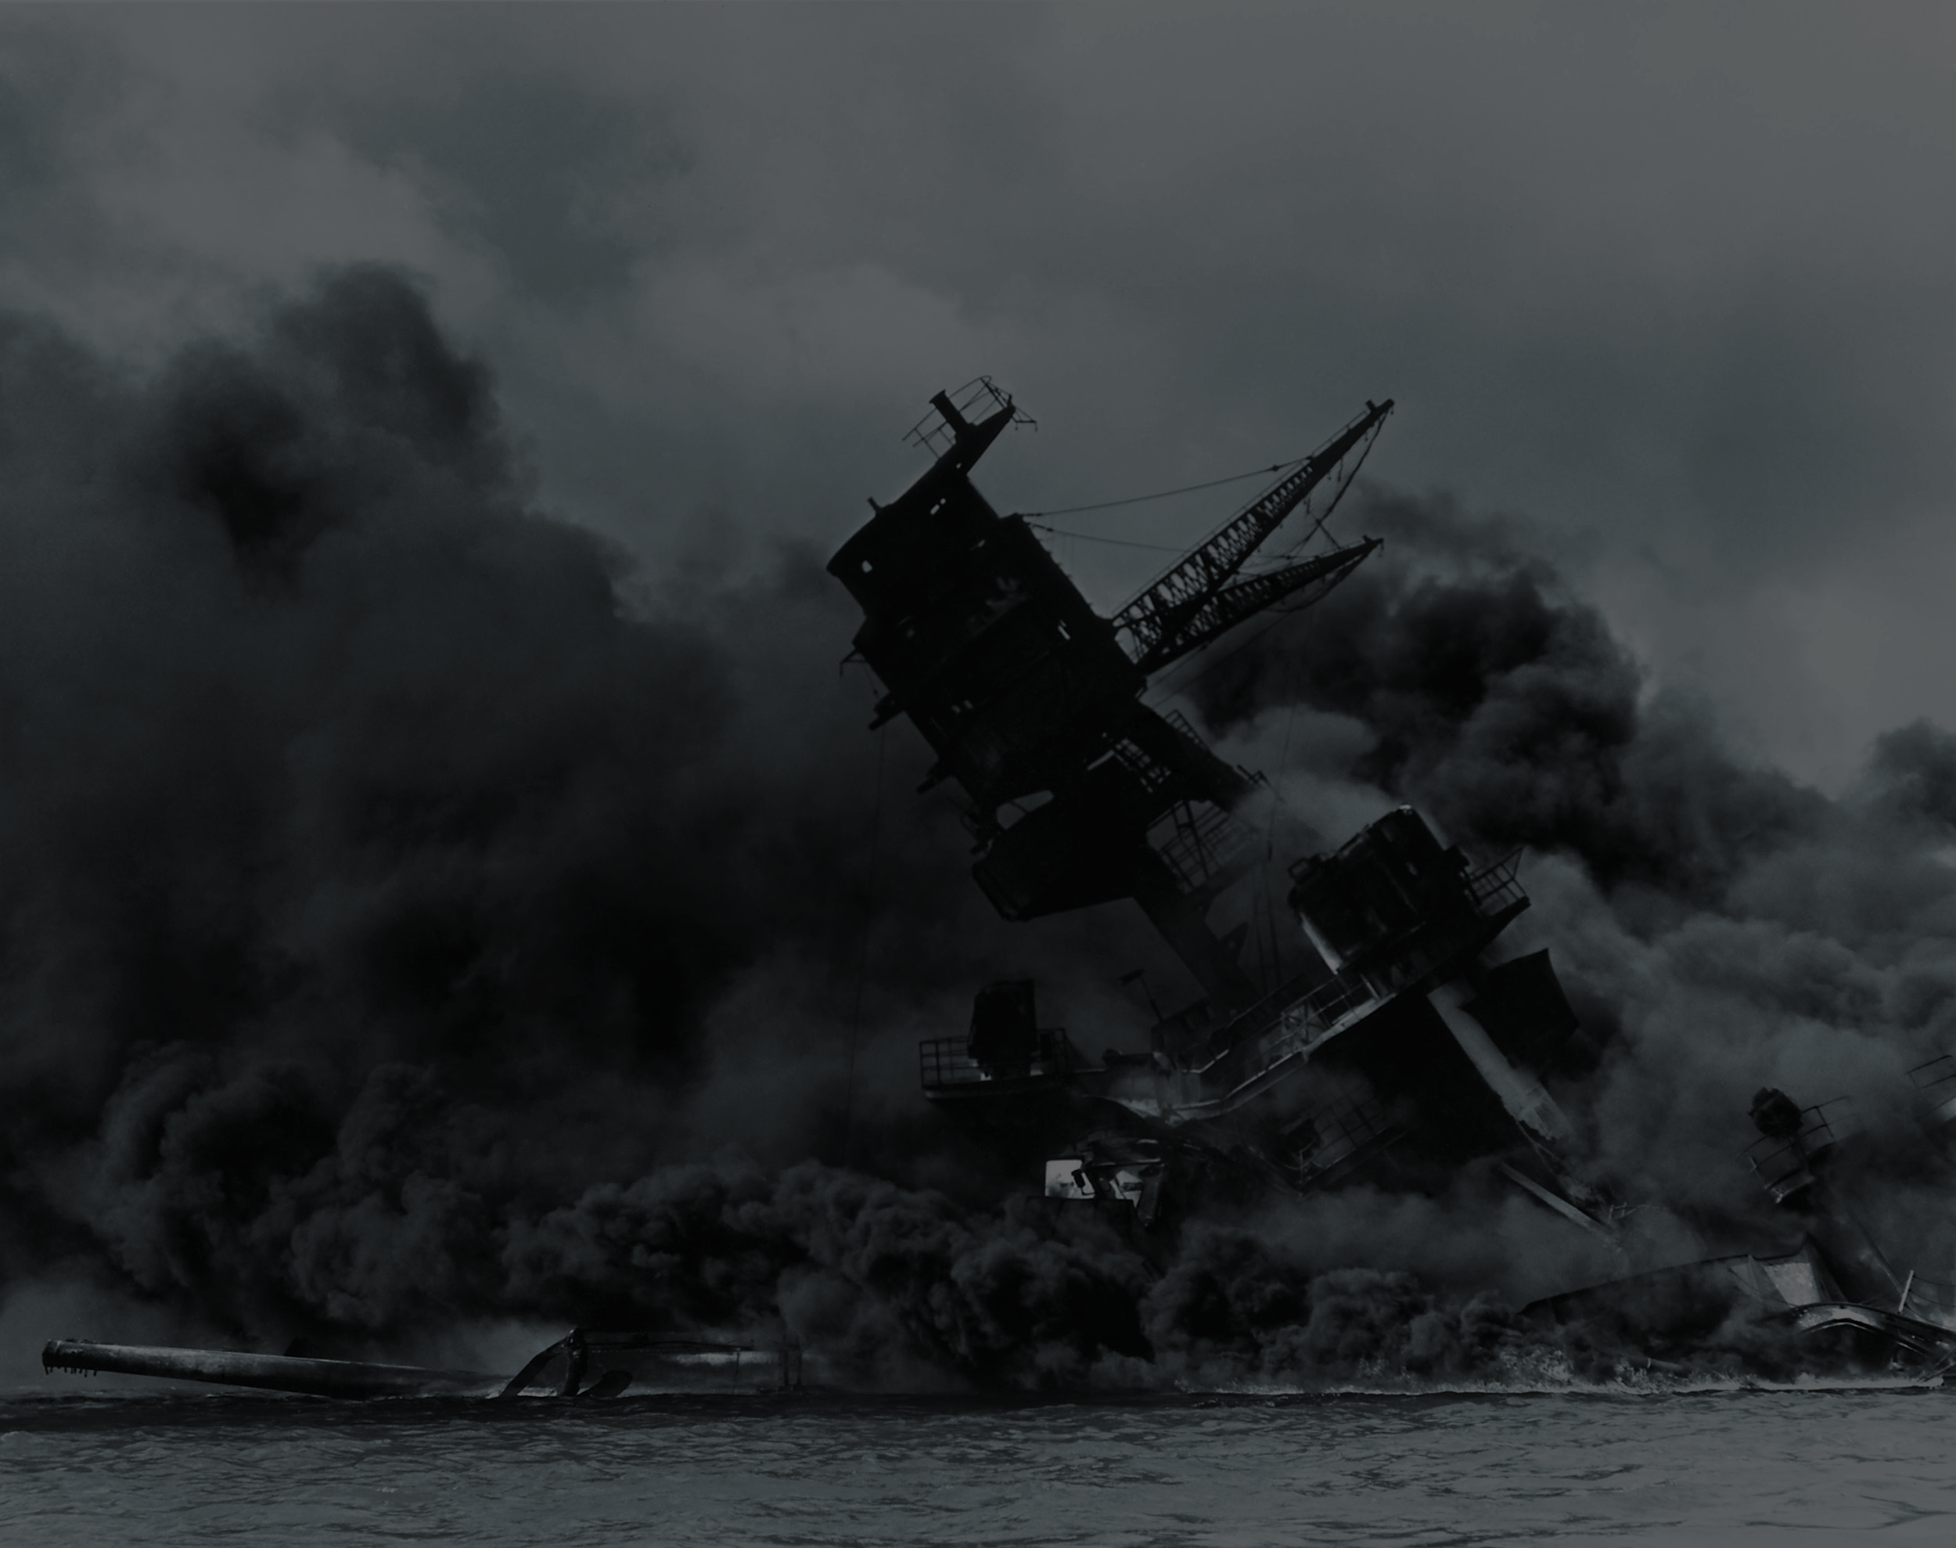
“...December 7th 1941, a date in which we will live in infamy...” President Roosevelt

Slide 3
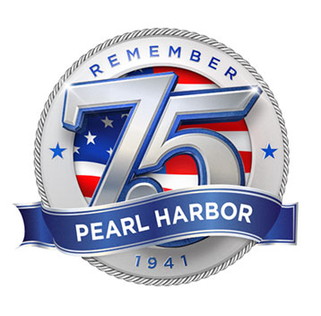


Background
Developed by LifeVR
Produced by Deluxe VR
Exclusive on HTC Vive.
Story based from Lt. James Downing, postmaster of the USS West Virginia.
To commemorate the 75th Anniversary of the Attack on Pearl Harbor.

Slide 4
Extension of the Times Inc.
Serves as a platform for immersive VR experiences.
Uses storytelling capabilities through 360 video and virtual reality to engage every passion from sports to entertainment.
Other VR experience: Star Wars : Rogue One Recon, Defying the Nazis, Lumen, etc

Slide 5
What is it?
First Person Documentary experience that takes user back in time to the 1940s.
Told from the perspective of WWII veteran Lt. James Downing.
The experience is in 4 segments, all with CGI.
Users would interact realistic objects of that era, and listen to Downing’s stories.
Consulted with National WWII Museum and Liberty of Congress

Slide 6
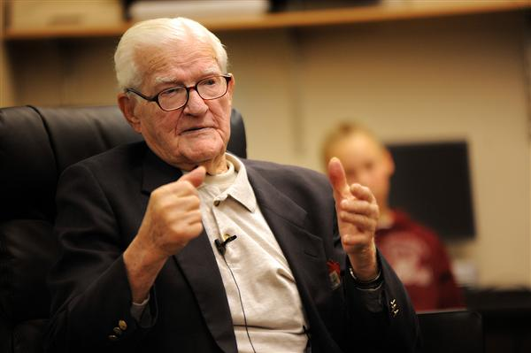
Lt. James Downing
Narrator for the Remembering Pearl Harbor Experience
Survivor of the Attack on Pearl Harbor
He’s the postmaster of the USS West Virgina
Sends letters and post boxes after the attack to the families of the fallen.

Slide 7
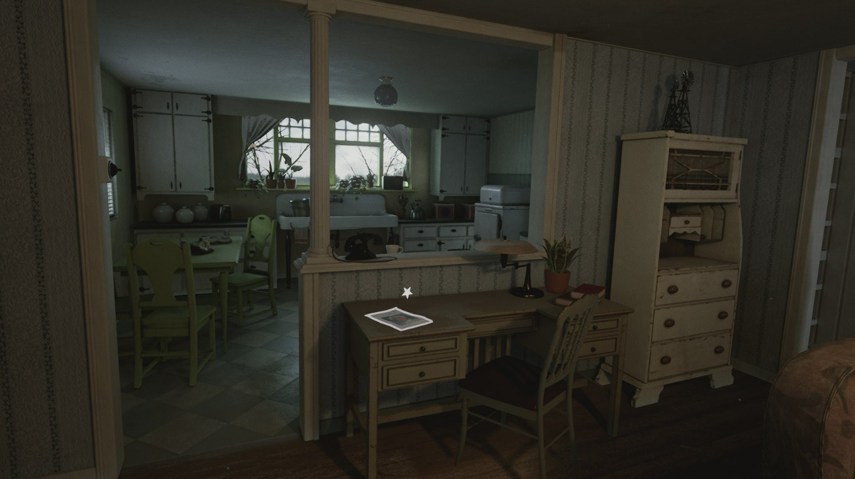
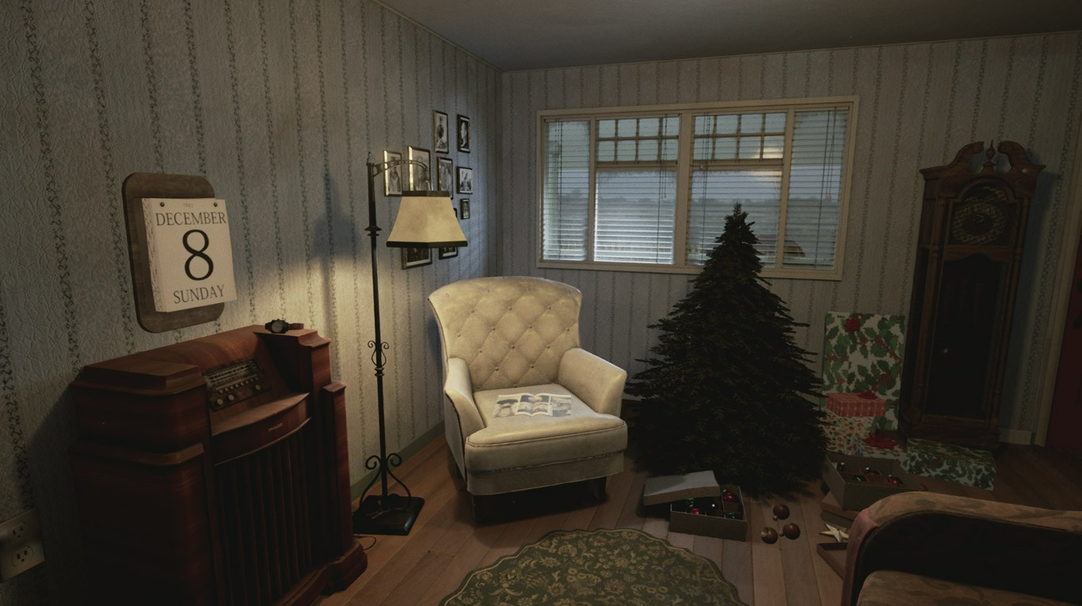
American Home
12/08/1941

Slide 8
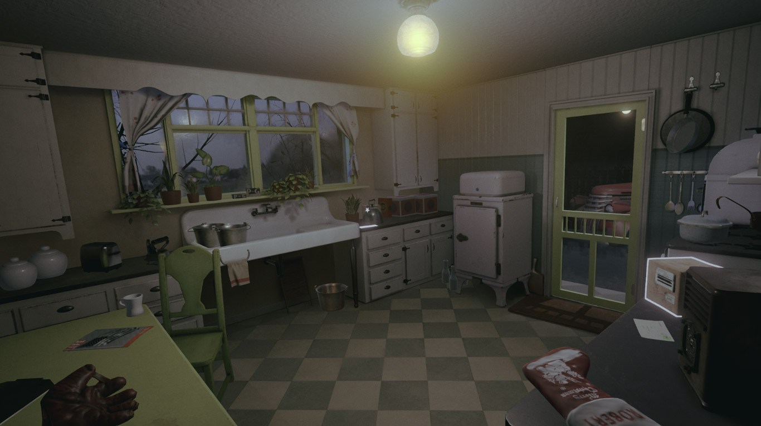
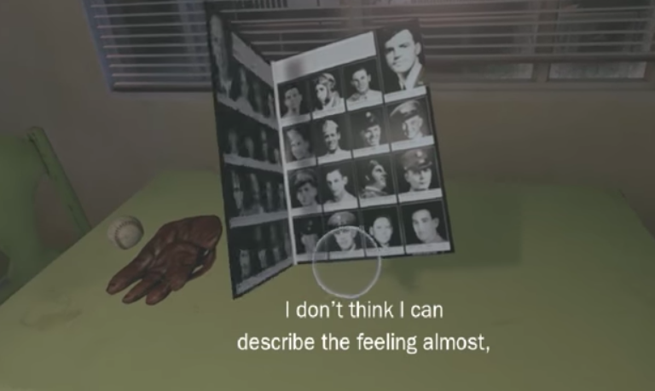
American Home
12/24/1941

Slide 9
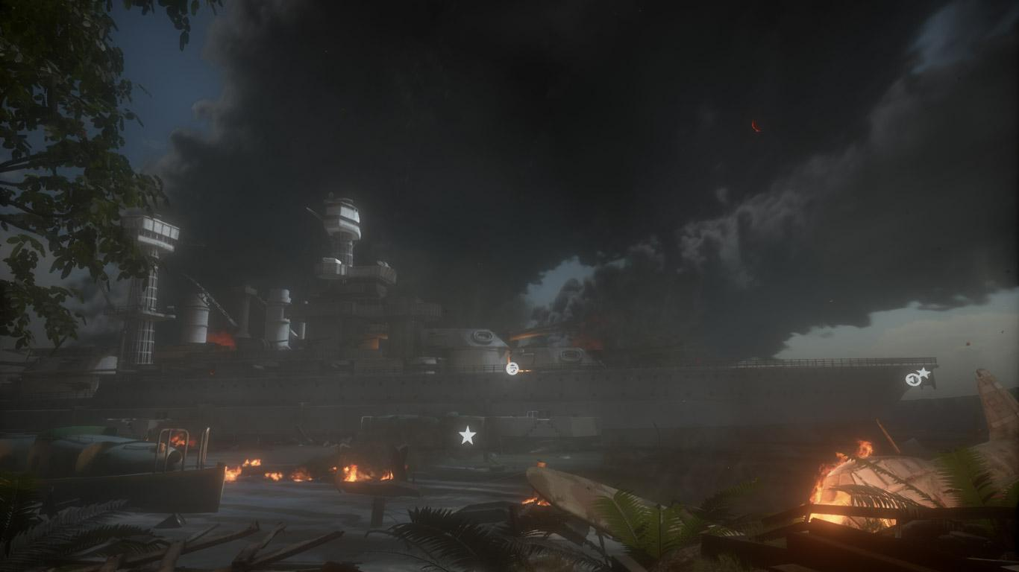
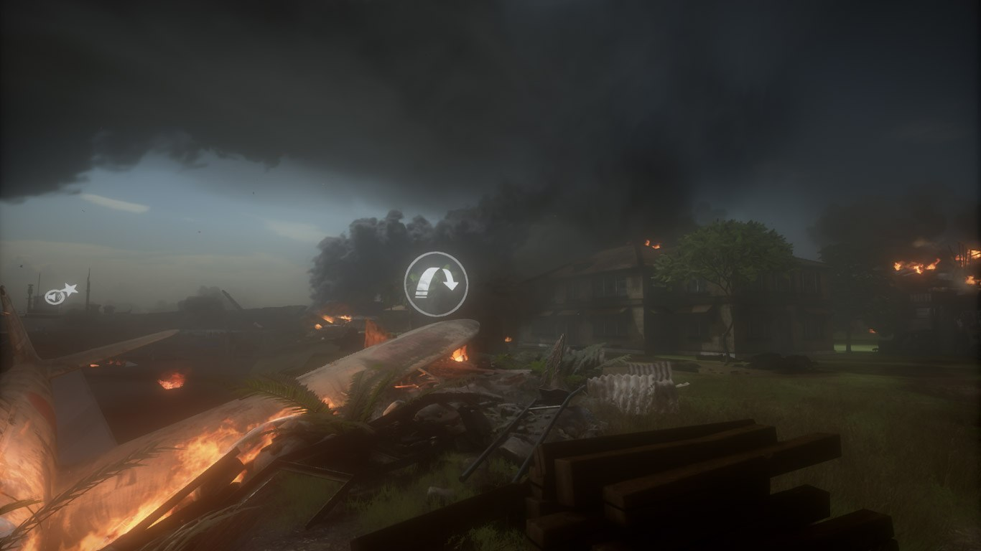
Attack on Pearl Harbor

Slide 10
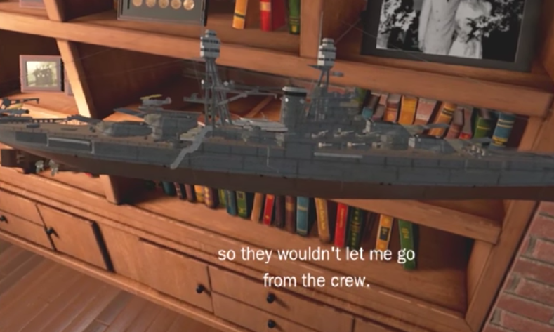
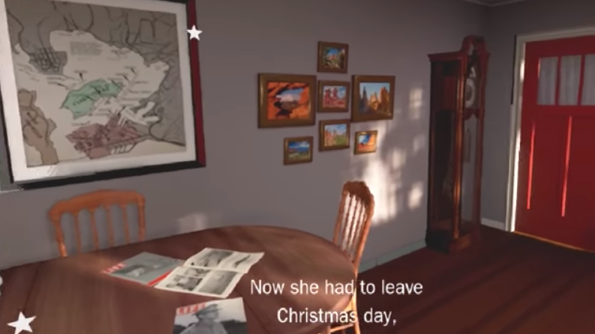
Present Day

Slide 11
Why is it Important?
Having a WWII veteran narrating is another great way to create empathy through VR.
People are able to interact and learn the stories behind the objects.
A perfect way to create a immersive experience in a museum environment and to introduce people to the subject.
Trailer of Remembering Pearl Harbor VR
https://www.youtube.com/watch?v=7fWNCUZjJ5Q

