Slide 1
Never Forget
Carly Port

Slide 2
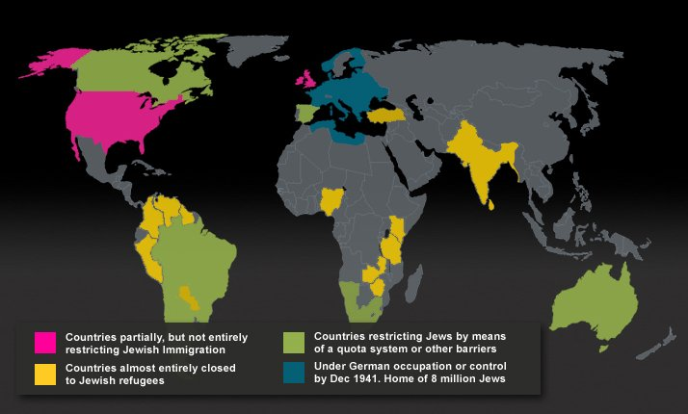
Audience

Slide 3
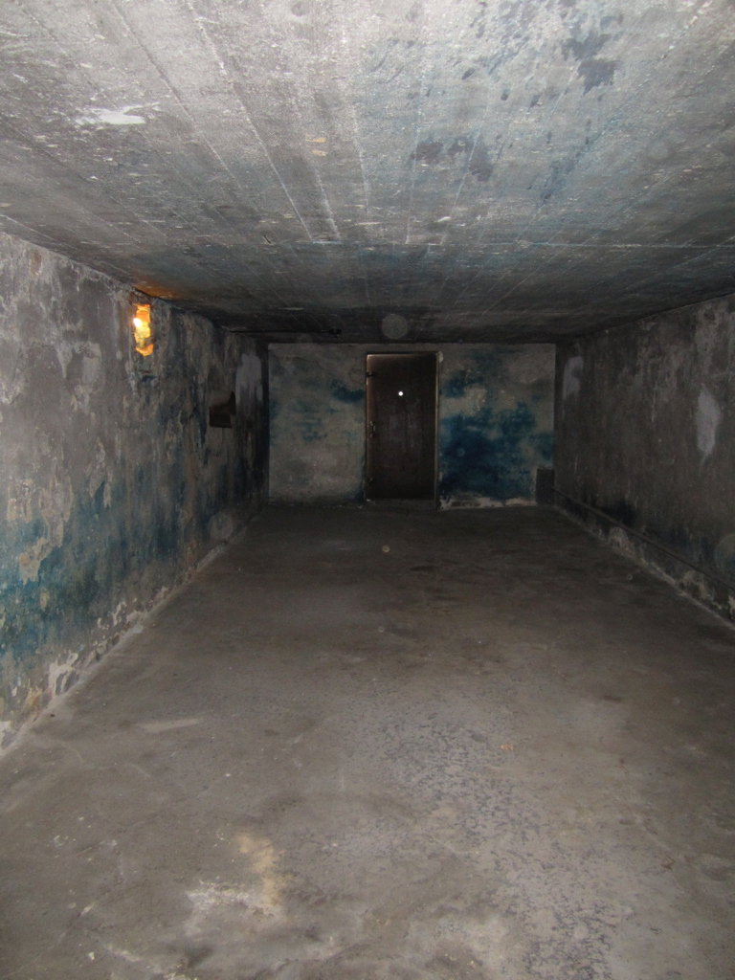
User Takeaways
History
Chilling effect
Tour conflicts

Slide 4
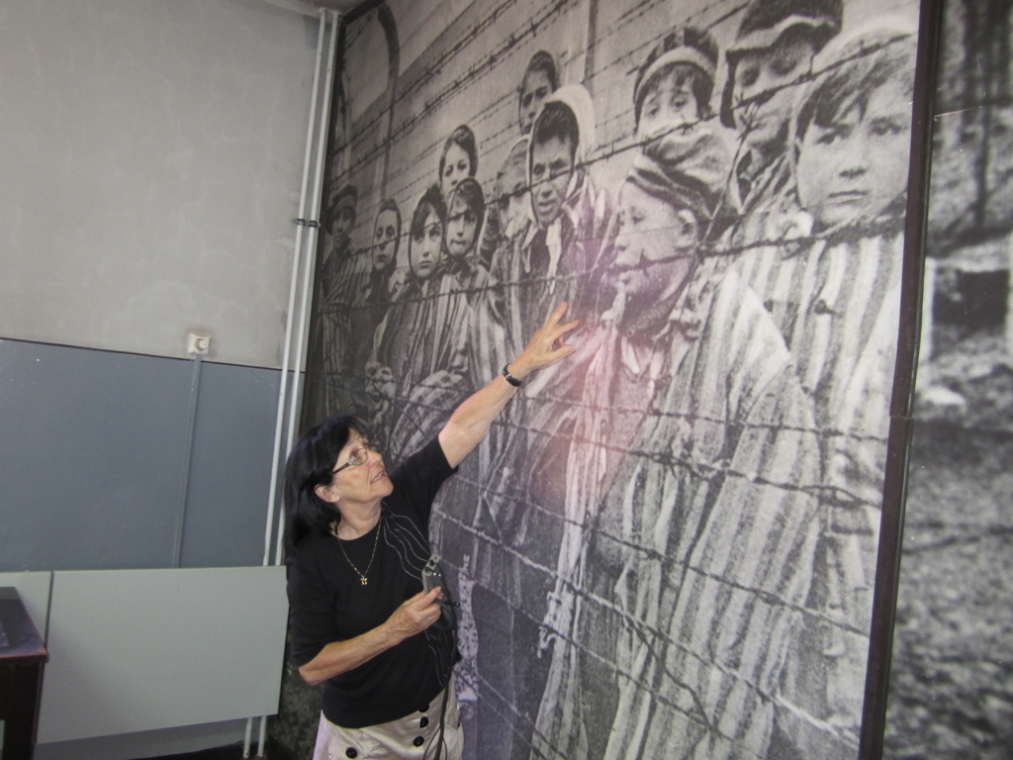
VR Storytelling Techniques
Audio triggers
Solo excavation
User-controlled

Slide 5
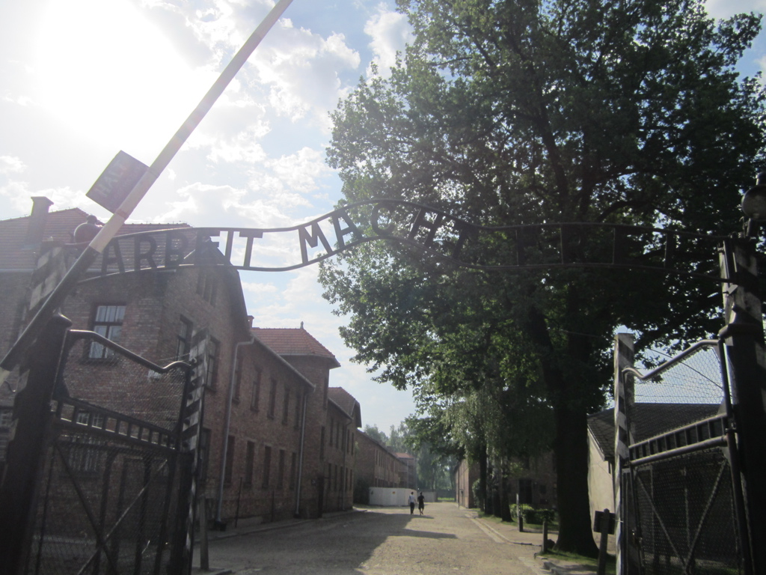
Anticipated Plan
Unity
Focus on symbolic structures
3D Modeling
Preserve the history

Slide 6
Application
VR in future career
Professional piece of content
Design of user experience
Argument for VR

