Slide 1
Dakota Access Pipeline in Unity
By: Jackie Prager

Slide 2
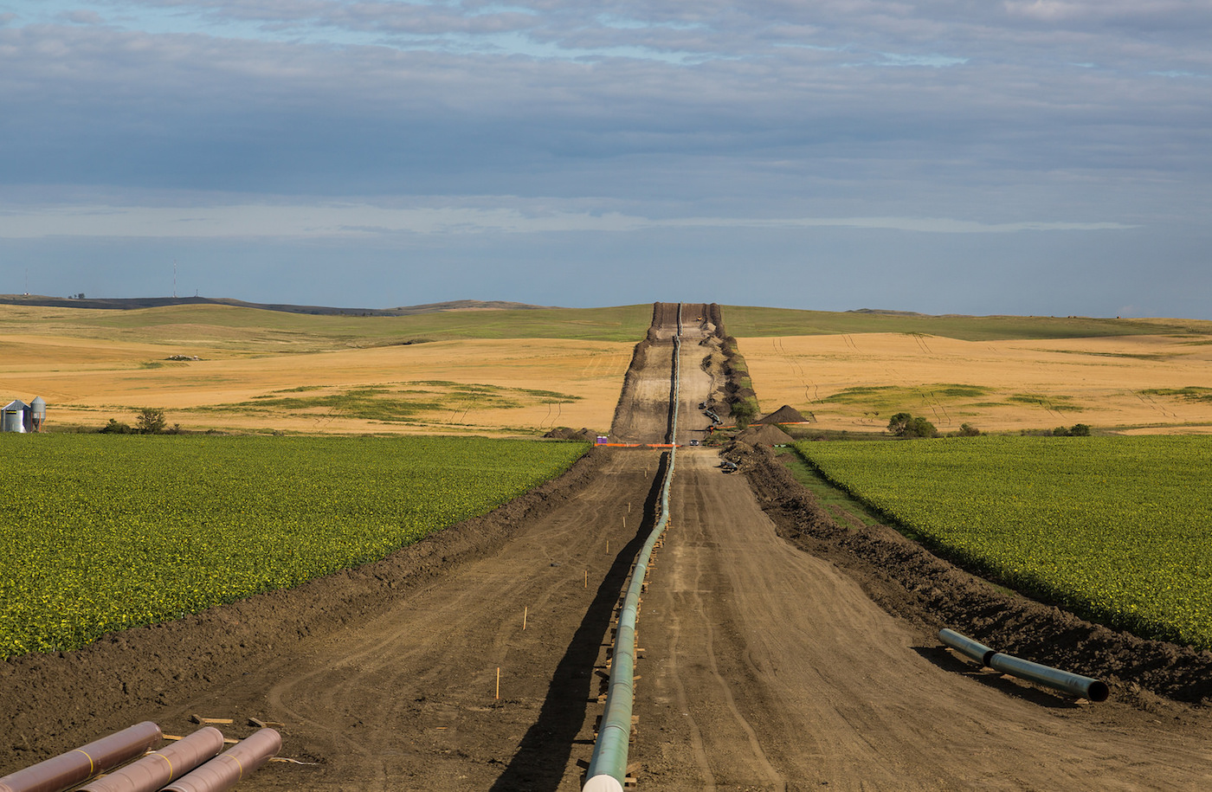
Experience: An immersive timeline of the Dakota Access Pipeline
Goal: To feel as though the user is experiencing the progression of what the situation is at the pipeline. This is to grasp a better understanding of what the issue is, what is happening there and why people are for or against the project.

Slide 3
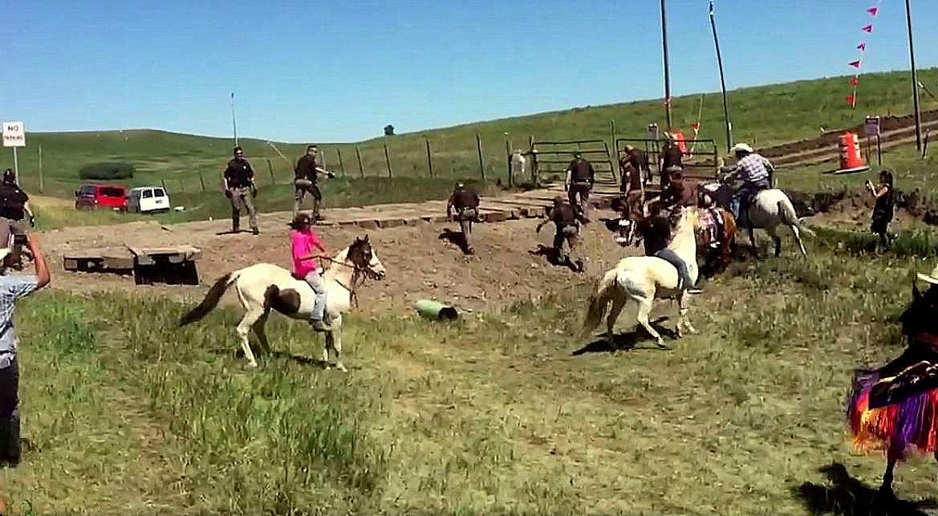
Target user: Anyone from teens to adults, activists, and people looking to get informed
After experiencing the scene, the user will be able to better grasp the situation and be able to understand what the pipeline is, why it’s being built, why the Standing Rock Sioux Tribe is upset and how the tribe and other activists are fighting to prevent the pipeline from being built.

Slide 4
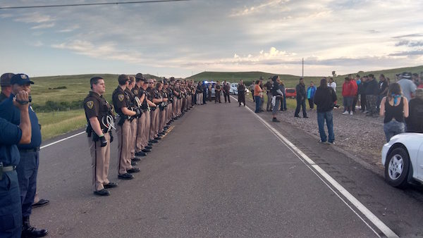
Story telling techniques:
  Progression from before the construction, construction, protests, and the current situation
  Narration throughout the progression of scenes to explain what’s going on
What may go wrong:
  Many difficulties in unity
    Making the characters and proper animations; police, activists, tribe members
    Unknown unity issues that may arise

Slide 5
Future Career
I’m studying broadcast journalism; this relates to my major by being a relevant news event
By creating a Unity experience, it is a different way to approach controversial news events. This will allow viewers to see the perspective of being in the situation while getting a narration that explains and breaks down the event

