Slide 1
Buy+
Online Shopping with VR Technology
Shumin Lai

Slide 2

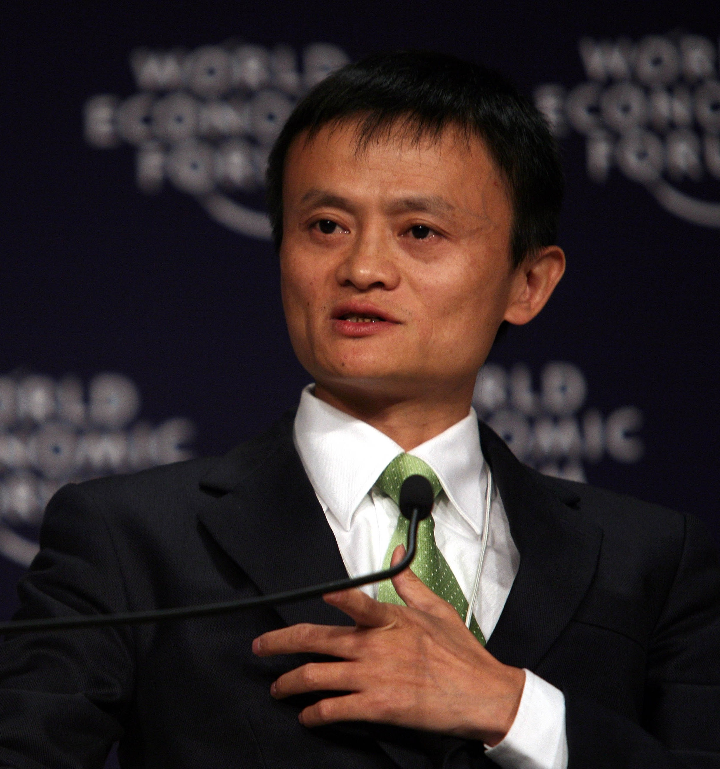
Alibaba Group by Jake Ma

Slide 3


online shopping website: TMALL

Slide 4
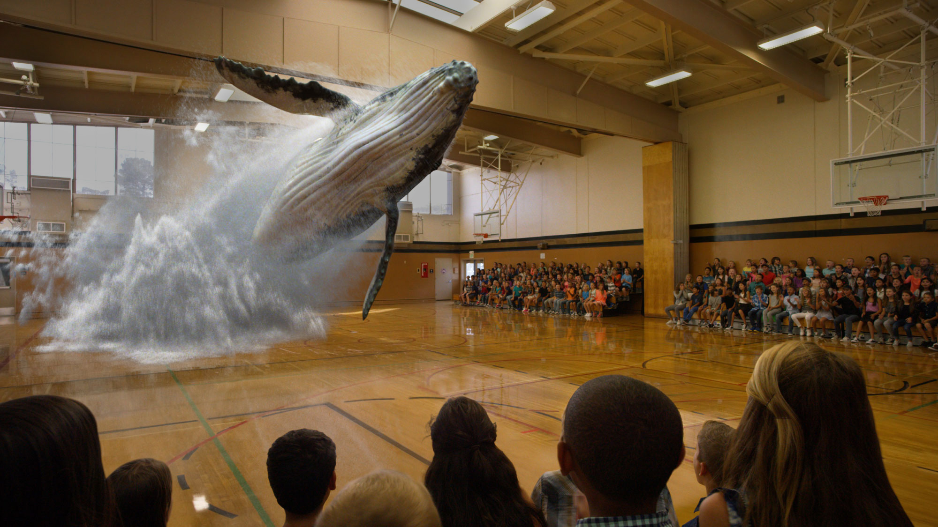
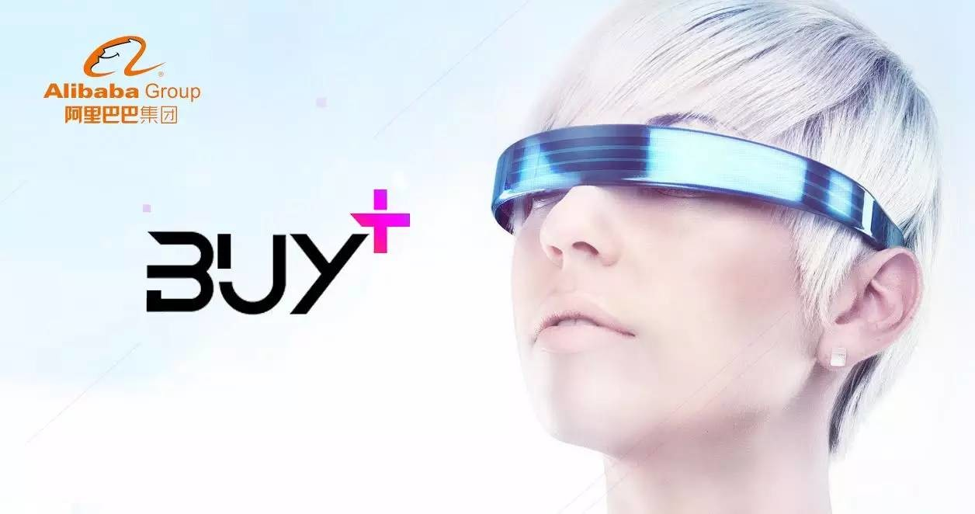

Buy+
Magic Leap
Gnome Magic Lab

Slide 5
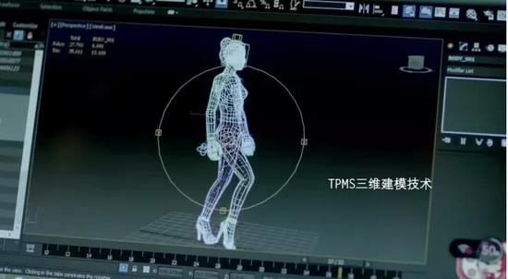
How to make It happen?

Slide 6
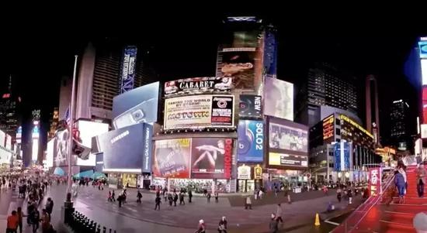
Benefits
• Shop at the virtual scene
• Have interactive experience
• Lower the shopping return rate
• Improve the shopping efficiency

Slide 7
Problems
• Is it true?
• Is it possible?
• Can people afford it?
• Can they realize interactivity?

Slide 8
Thanks!

