Slide 1
Coachella 2016: The Experience

Slide 2


Slide 3
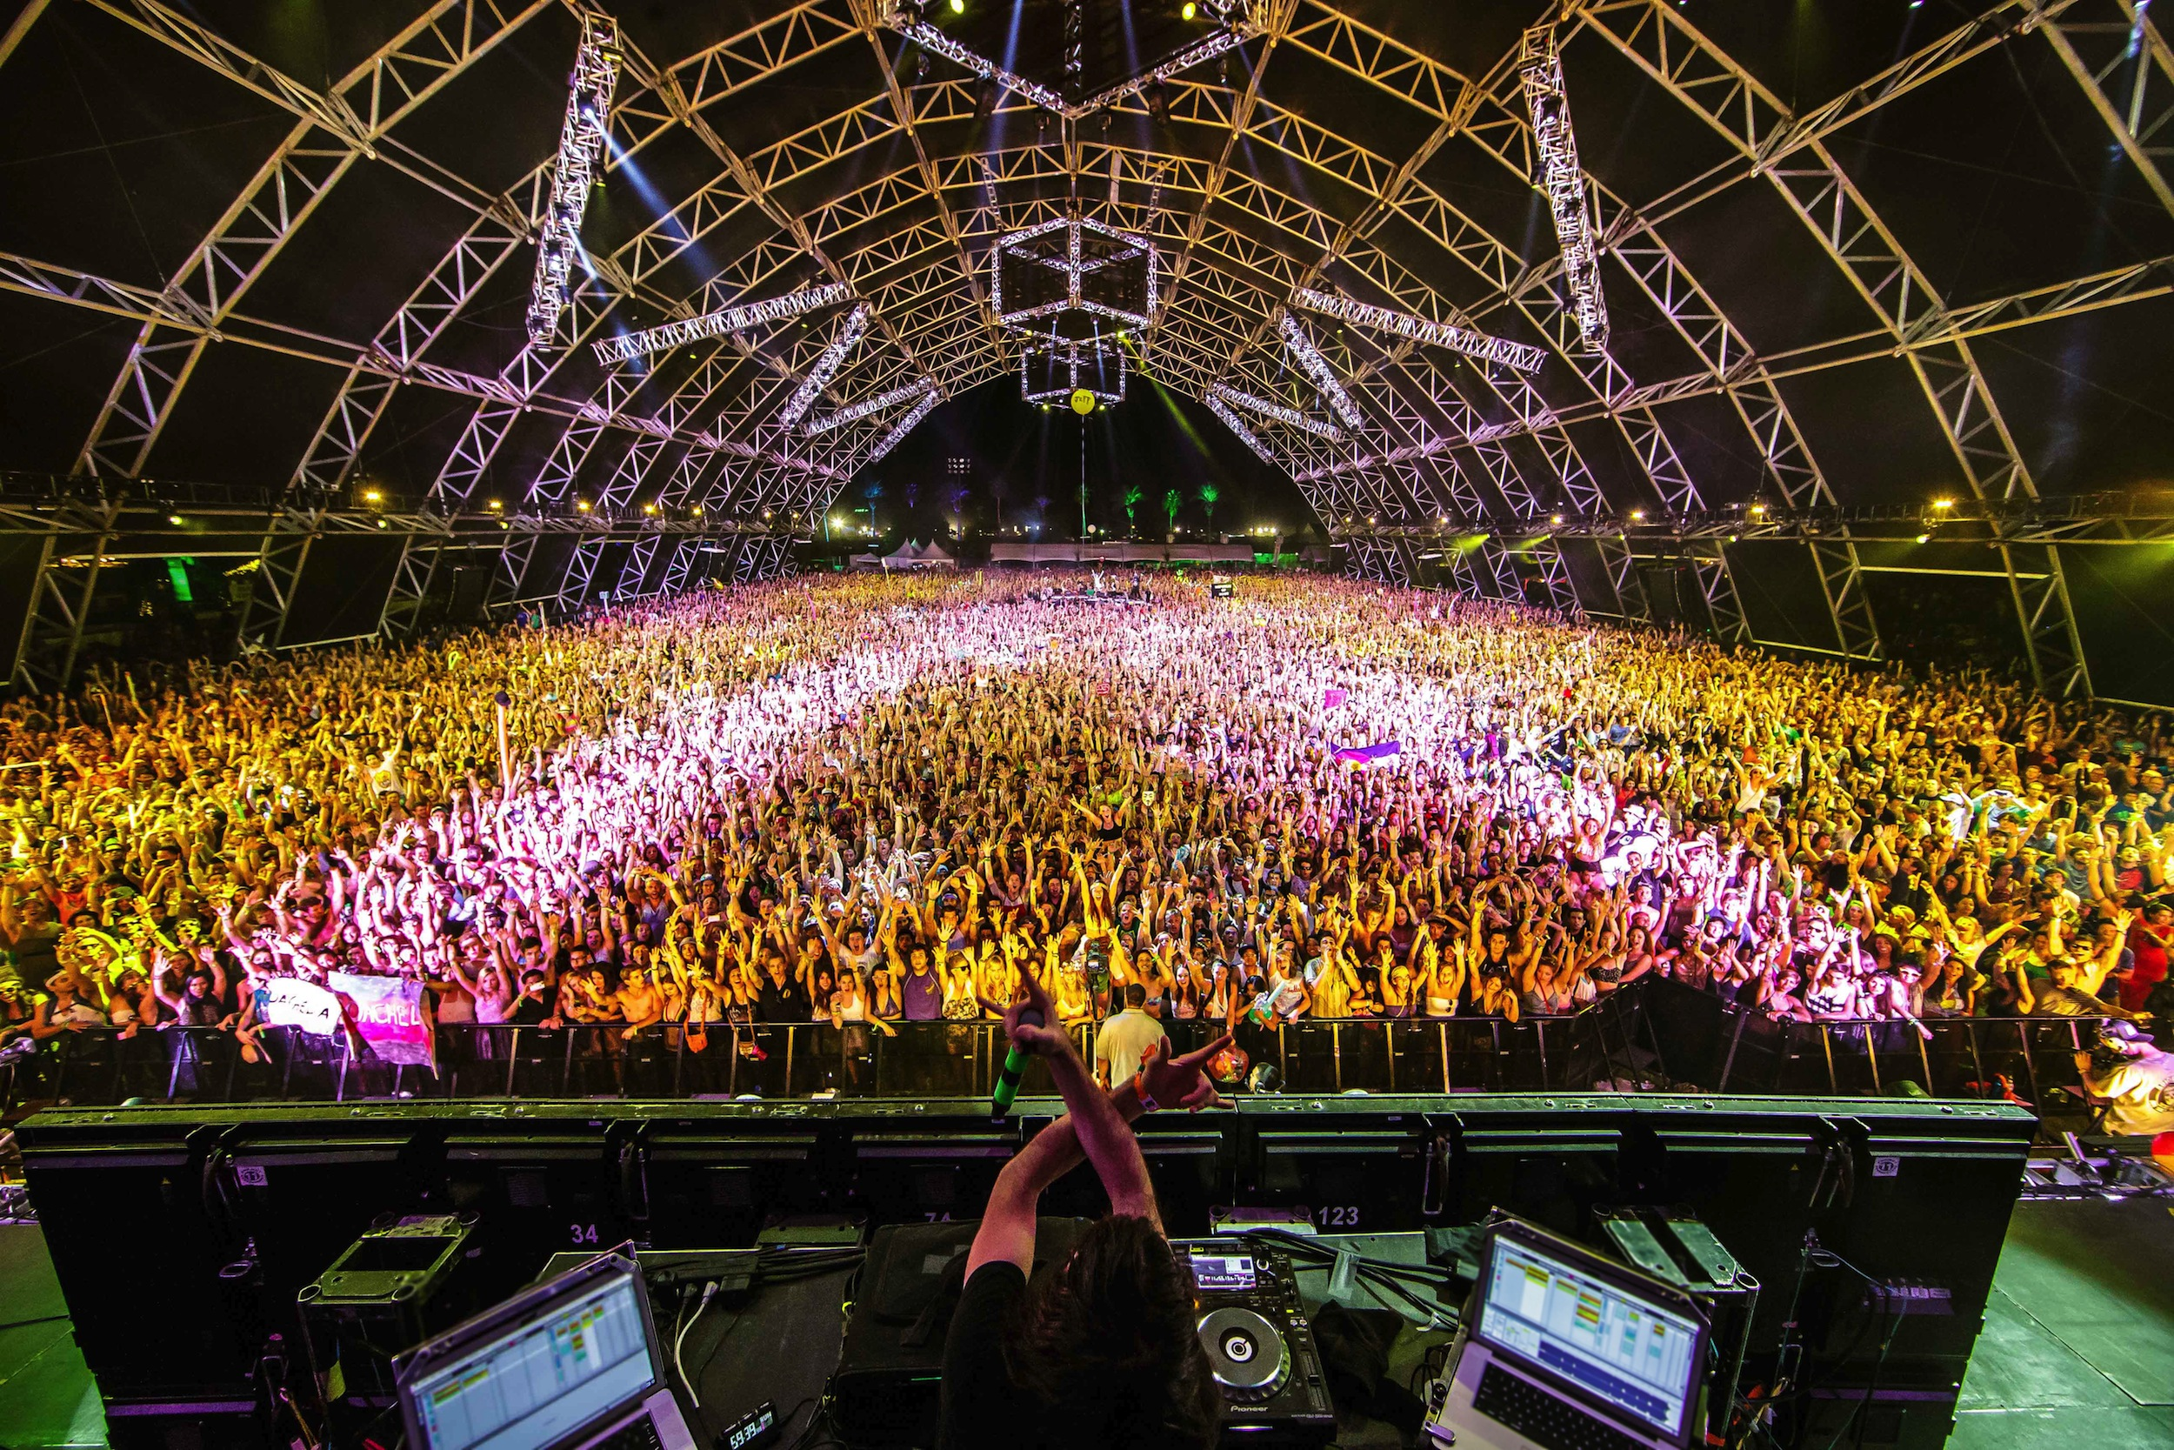

Slide 4

The Coachella 2016 VR Experience

Slide 5
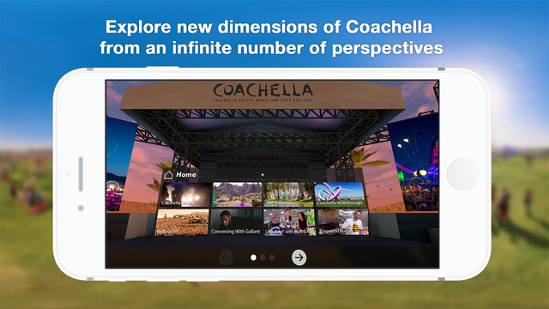
The Coachella 2016 VR Experience

Slide 6
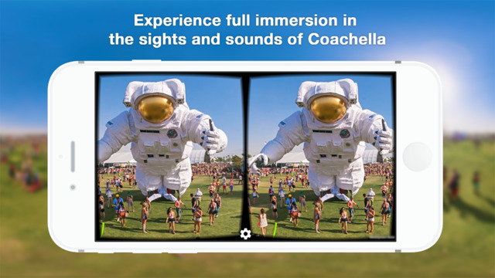
The Coachella 2016 VR Experience

Slide 7
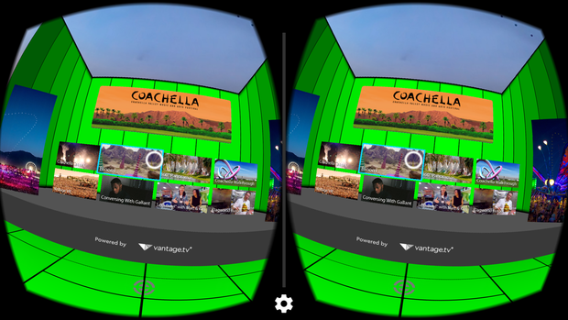
App Features
Concert experiences
Interviews
Panoramic Photos

Slide 8
Coachella Welcome Box

Slide 9
Critiques
Not a lot of ground-breaking storytelling
Can only be viewed in Cardboard or Samsung GearVR
Can’t tap a screen with Cardboard headset

Slide 10
On The Other Hand…
It’s free

