Slide 1

I am hungry
Notes:
Ride in with a Jimmy Johns’ sub for Chazz
Don’t Forget to:
Get black and blue mark on leg
Pick up Sandwich (In civilian attire)
Deck out bike in Jimmy Gear
Buy Cookies?

Slide 2
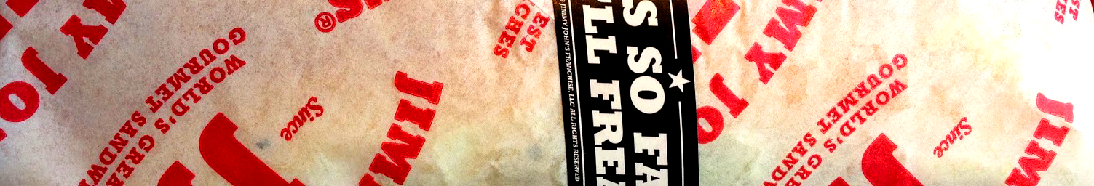
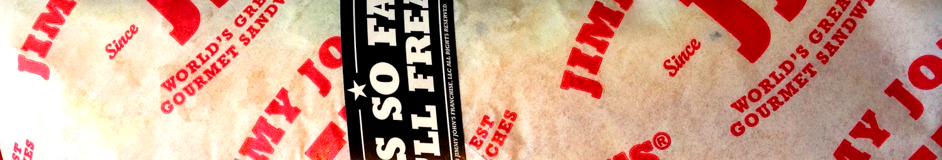
BUT…
That sandwich is wrapped in some pretty nasty news
Notes:
Ask for wrapper, read off facts:
Half of the people who helped make that sandwich receive government assistance
Opportunities to rise through the ranks are limited, Virtually nobody ever works their way to owning a store
Over 90%, do not get paid Sick Days. Instead of resting when I was in the hospital two weeks ago, I was on my cell phone trying to find someone to cover for me.
SOOO…. With the Food and Service sector growing, my idea is to

Slide 3
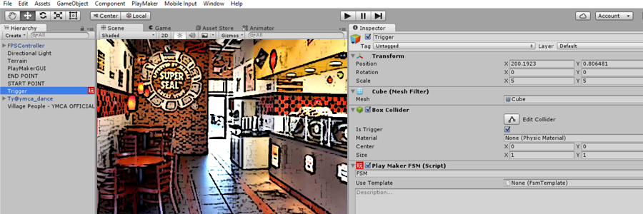

My Idea: Use to build a generic VR sandwich shop
Notes:
Use Unity to build a generic VR sandwich shop which will highlight many of the social issues with the industry
Ideas:
Sneezing worker to represent lack of sick days
Shift Clock – The industry tries to keep most workers as part time to avoid benefits
Manager – Limited upward mobility
Attack by Thirsty Thursday crowd
And trust me there are plenty of work place hazards (cut on leg?)

