Slide 1
The Interplay Between 2D Games and 3D Games

Slide 2
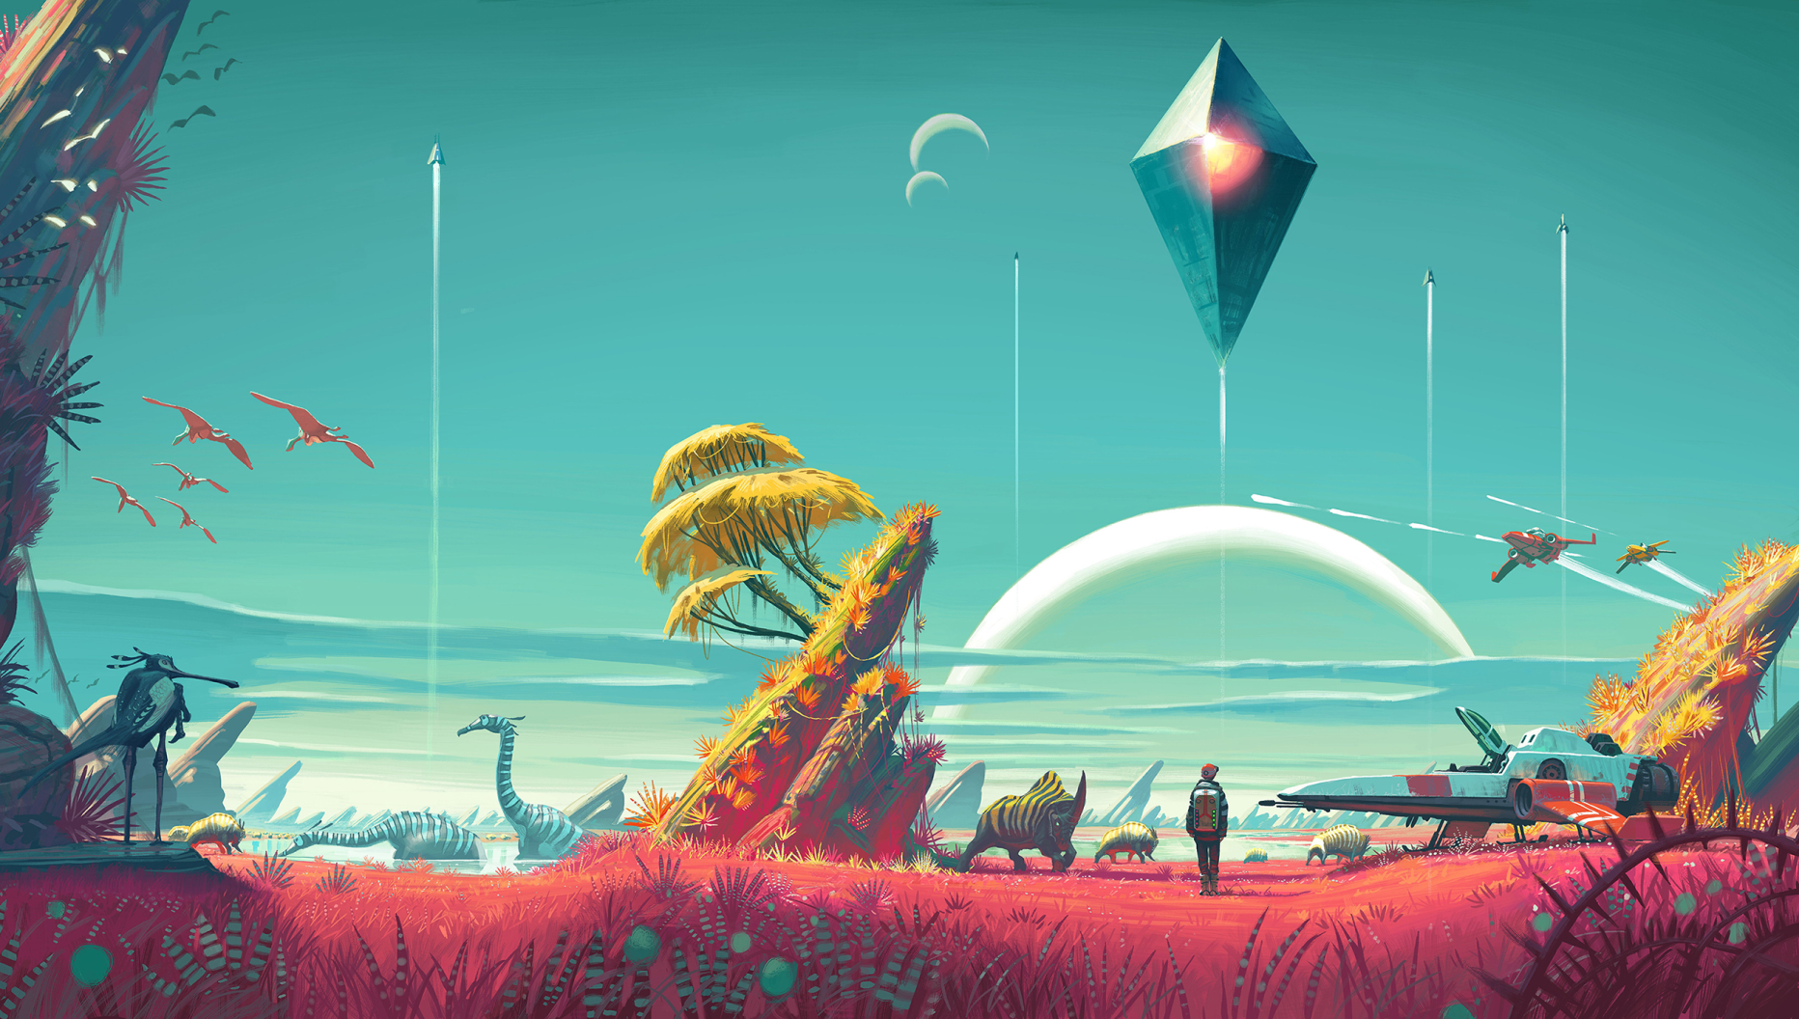
No Man’s Sky

Slide 3
What is No Man’s Sky
A procedurally generated Sci-Fi Adventure games
What is procedural generation?
Why is this so freaking awesome?

Slide 4
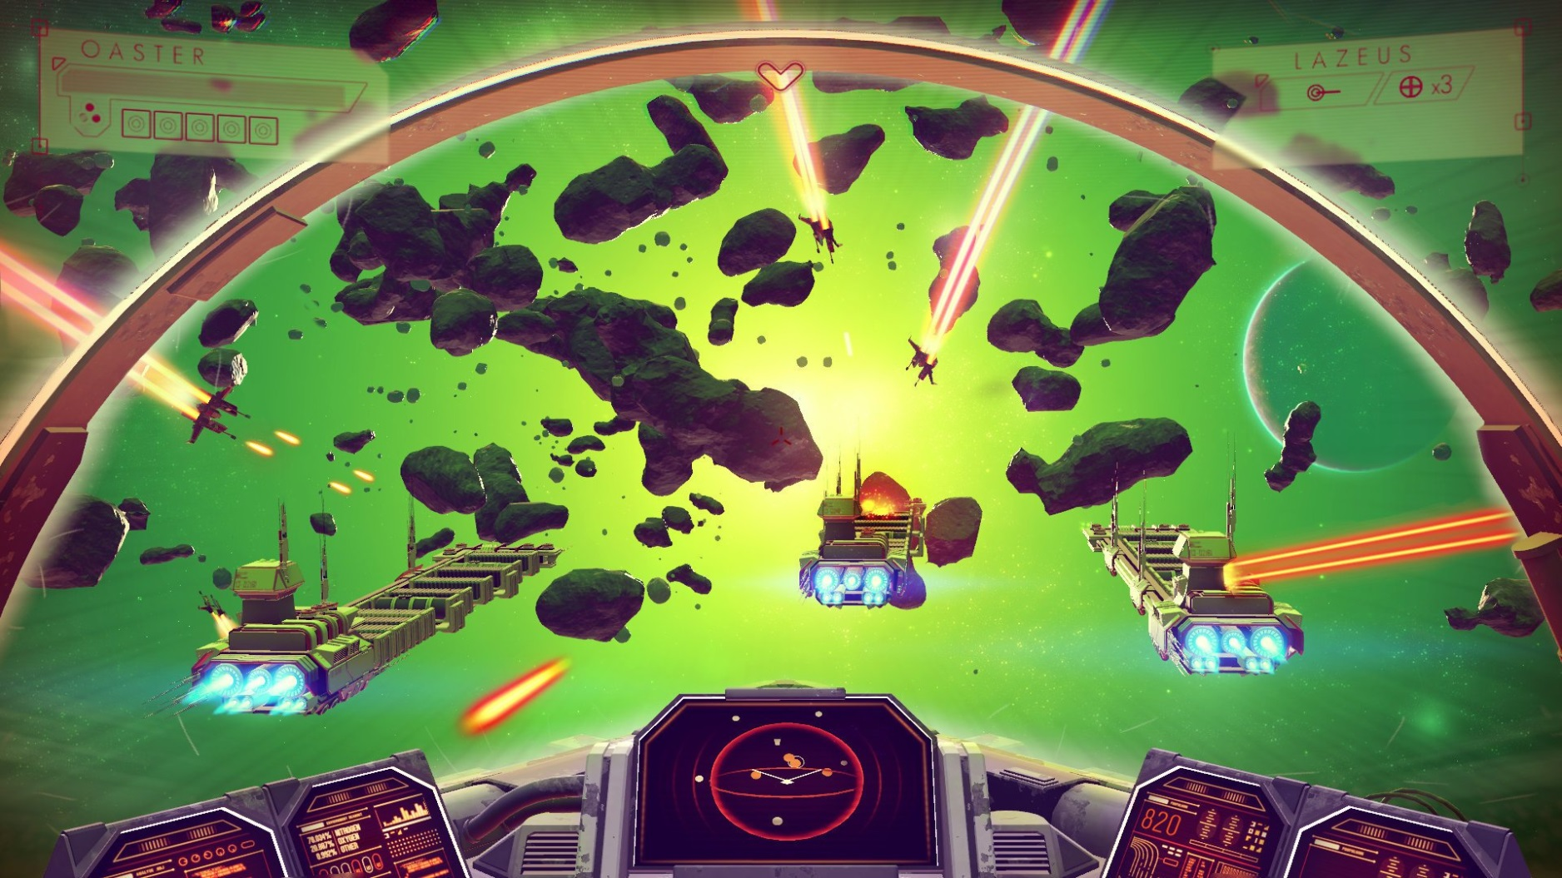
CARDBOARD SUPPOOOORT

Slide 5
VR Parlors
https://www.facebook.com/techinsider/videos/420699281461767/

Slide 6
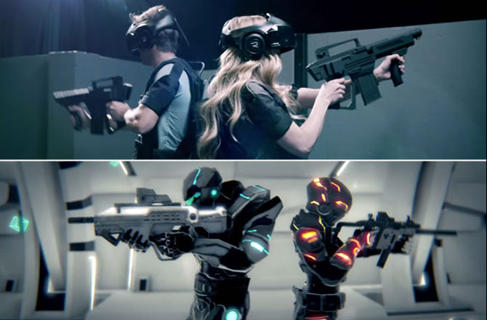

Slide 7
So Why Make the Jump
Why jump from 2d to 3d

Slide 8
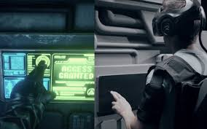
Immersion

Slide 9
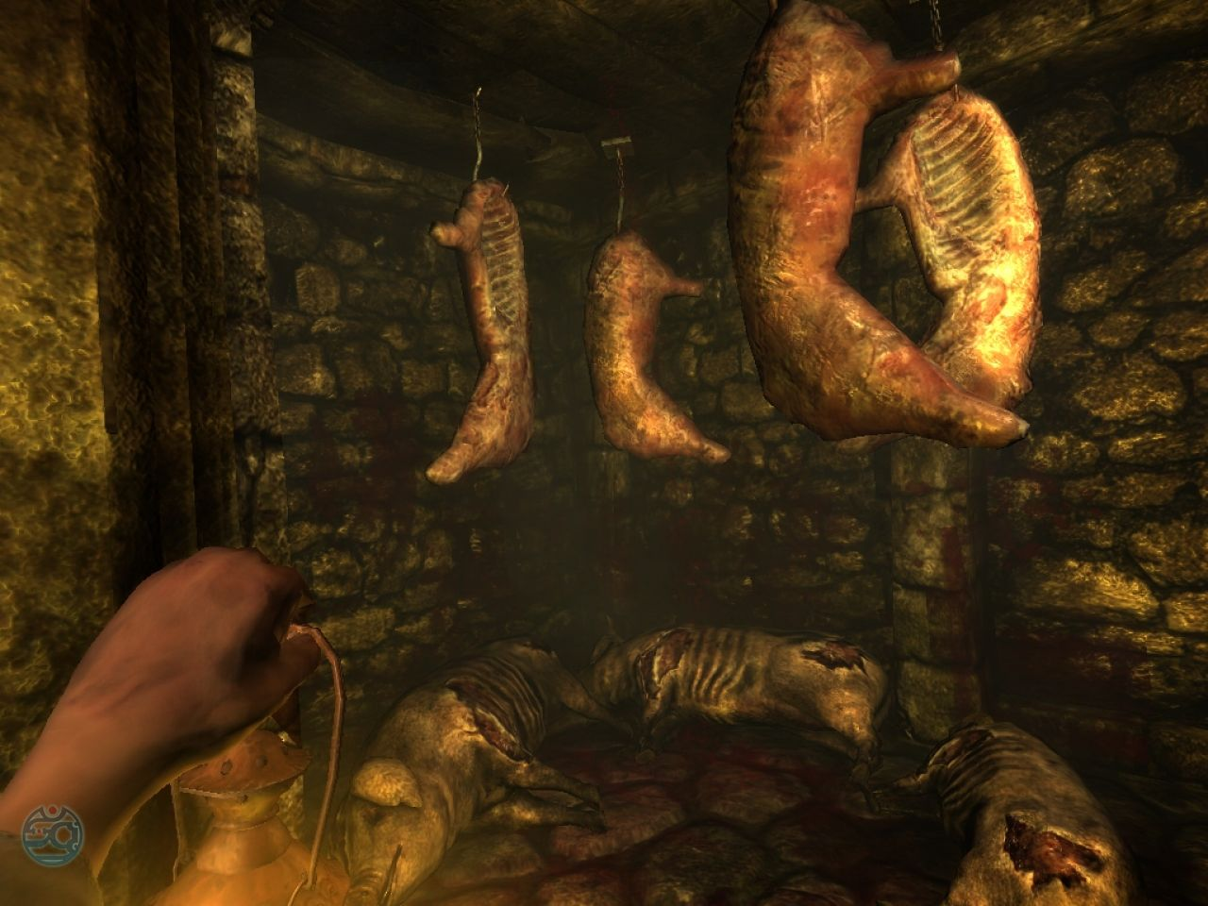
Plenty of Titles

Slide 10

Opportunity for Additional Revenue

